Slide 1


AF in Pregnancy
Elnur Isayev, MD, PhD
Azerbaijan Medical University
25 September 2022

Slide 2
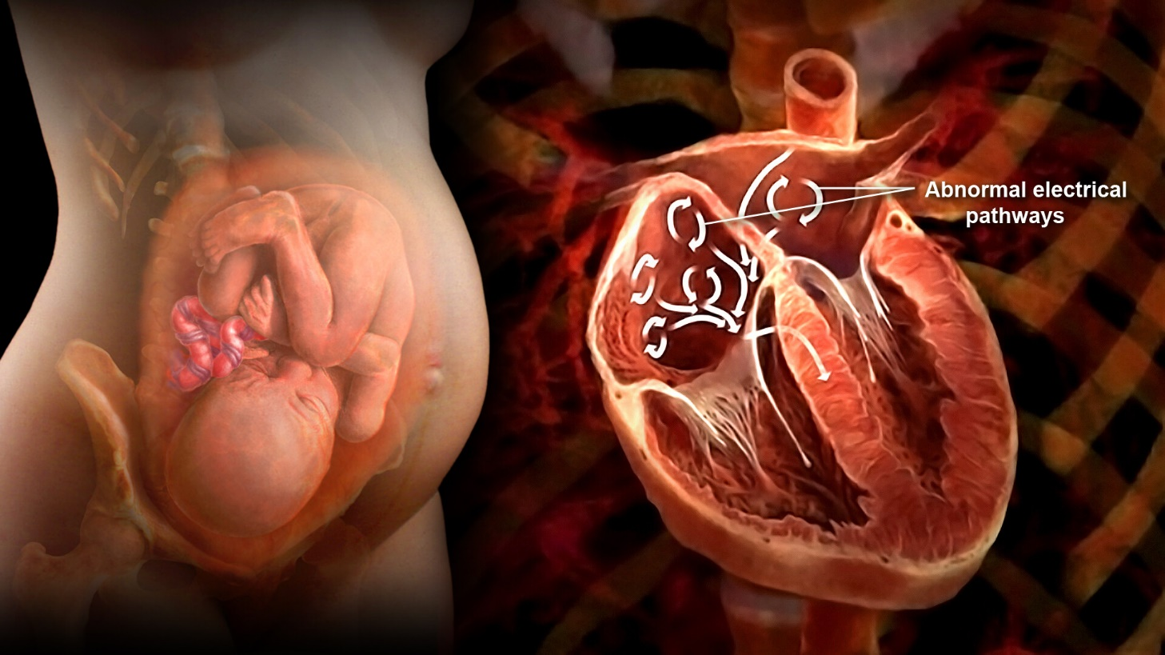
AF
AF in a structurally normal heart during pregnancy is very rare with a reported prevalence of 0.06%, particularly met at late pregnancy and in older women.
Elnur Isayev, MD, PhD – Quba 25.09.2022
Lee MS, Chen W, Zhang Z, et al. Atrial fibrillation and atrial flutter in pregnant women-A population-based study. J Am Heart Assoc 2016;5(4):e003182.

Slide 3
Epidemiology
Lee et al. - 264,730 pregnancies in the Southern California.
AF was more frequent in white women and in older maternal age.
Odds of AF episodes were higher during the third trimester compared with the first.
Adverse maternal cardiac events were rare in AF pregnant women, since only two patients who developed heart failure were reported.
There were no strokes or maternal deaths.
Elnur Isayev, MD, PhD – Quba 25.09.2022
Lee MS, Chen W, Zhang Z, et al. Atrial fibrillation and atrial flutter in pregnant women-A population-based study. J Am Heart Assoc 2016;5(4):e003182.

Slide 4
Risk Factors
Rheumatic or valvular heart disease
Peripartum cardiomyopathy
Hypertrophic cardiomyopathy
Congenital heart disease
Hypertension, hyperlipidemia, diabetes, and increased maternal age
Hyperthyroidism
Electrolyte imbalances
Alcohol abuse
Terbutaline and nifedipine administered during tocolysis
Regitz-Zagrosek V, Roos-Hesselink JW, Bauersachs J, et al. 2018 ESC Guidelines for the management of cardiovascular diseases during pregnancy. Eur Heart J 2018;39(34):3165e241.
Elnur Isayev, MD, PhD – Quba 25.09.2022

Slide 5
Pathophysiology

Slide 6
Pathophysiology
The precise mechanism of increased arrhythmia burden during pregnancy is unclear, but it has been attributed to hemodynamic, hormonal, and autonomic changes related to pregnancy.
Increased blood volume, cardiac output, and heart rate resulting from the activation of the sympathetic nervous system and the renin-angiotensin-aldosterone system.
Elnur Isayev, MD, PhD – Quba 25.09.2022
Enriquez AD, Economy KE, Tedrow UB. Contemporary management of arrhythmias during pregnancy. Circ Arrhythm Electrophysiol October 2014;7(5):961e7.

Slide 7
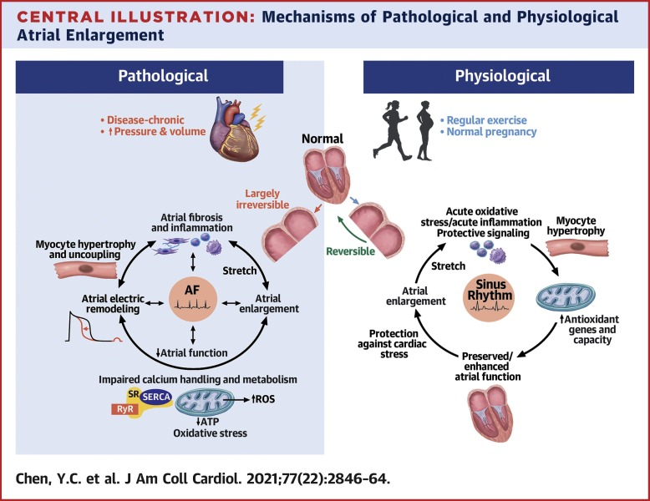
Pathophysiology
Increased levels of estrogen and progesterone, which can also modulate remodeling of the myocardium, particularly cardiac hypertrophy.
Elevated progesterone levels may lead to alterations in gastrointestinal motility, and the prevalence of gastroesophageal reflux disease has been reported to be up to 80% in pregnant women, thus suggesting a possible mechanism for AF development.
Elnur Isayev, MD, PhD – Quba 25.09.2022
Enriquez AD, Economy KE, Tedrow UB. Contemporary management of arrhythmias during pregnancy. Circ Arrhythm Electrophysiol October 2014;7(5):961e7.

Slide 8
Classification of AF
Recommendations for the management of AF during pregnancy - ESC 2020

Slide 9

Diagnostic approach
According to the American College of Obstetricians and Gynecologists:
MRI is not associated with risk and is the imaging technique of choice for the pregnant patient.
Elnur Isayev, MD, PhD – Quba 25.09.2022
Enriquez AD, Economy KE, Tedrow UB. Contemporary management of arrhythmias during pregnancy. Circ Arrhythm Electrophysiol October 2014;7(5):961e7.

Slide 10
Modified World Health Organization (WHO) Classification of Maternal
Cardiovascular Risk

Slide 11
Rhythm control therapy - acute phase
Electrical cardioversion:
Energy requirements in pregnant and nonpregnant women are similar, and synchronized electrical CV is effective in most cases, utilizing 50-100 J.
Risk of inducing fetal arrhythmias is limited since the amount of current that reaches the uterus is small and fibrillation threshold in fetuses of mammals is high.
Elnur Isayev, MD, PhD – Quba 25.09.2022

Slide 12
Rhythm control therapy - acute phase
Pharmacological cardioversion in patients without heart disease:
Ibutilide - 75%-80%
Up to a 4% risk of Torsade de Pointes (TdP) and a 4.9% risk of monomorphic VT, close monitoring 4 h.
Flecainide - 78.6%
Suggested that rate-control drugs such as b-blockers should be administered along with class Ic antiarrhythmic drugs in Afl, because class Ic antiarrhythmic agents may slow the flutter rate and induce one-to-one atrioventricular (AV) conduction.
Quinidine
Elnur Isayev, MD, PhD – Quba 25.09.2022
Recommendations for the management of AF during pregnancy - ESC 2020

Slide 13
Rhythm control therapy - acute phase
Pharmacological cardioversion in patients with heart disease:
Amiodarone
Each 200-mg tablet contains 75 mg of iodine, and this additional iodine load may result in serious adverse effects for the fetus.
Amiodarone should also be avoided for acute restoration of sinus rhythm.
Regitz-Zagrosek V, Roos-Hesselink JW, Bauersachs J, et al. 2018 ESC Guidelines for the management of cardiovascular diseases during pregnancy. Eur Heart J 2018;39(34):3165e241.

Slide 14
Rhythm control therapy - long term
Cardioselective b-blocker (metoprolol or bisoprolol)
In women without structural heart disease, flecainide and sotalol.
Sotalol should not be used in patients with impaired systolic heart function or significant left ventricular hypertrophy.
In women with impaired systolic heart function – Amiodarone.
Regitz-Zagrosek V, Roos-Hesselink JW, Bauersachs J, et al. 2018 ESC Guidelines for the management of cardiovascular diseases during pregnancy. Eur Heart J 2018;39(34):3165e241.

Slide 15
Rate control therapy - acute phase, long term
ESC guidelines favor the use of b-blockers (except atenolol) and/or digoxin.
Digoxin blood levels monitoring may be unreliable in pregnancy.
Propranolol is considered relatively safe in pregnancy.
Limited evidence exists for nondihydropyridine calcium channel blockers.
Regitz-Zagrosek V, Roos-Hesselink JW, Bauersachs J, et al. 2018 ESC Guidelines for the management of cardiovascular diseases during pregnancy. Eur Heart J 2018;39(34):3165e241.
Elnur Isayev, MD, PhD – Quba 25.09.2022

Slide 16
Antiarrhythmic treatment during pregnancy
Elnur Isayev, MD, PhD – Quba 25.09.2022

Slide 17
Recommendations for the management of AF during pregnancy - ESC 2020
Elnur Isayev, MD, PhD – Quba 25.09.2022
Recommendations for the management of AF during pregnancy - ESC 2020

Slide 18
Catheter ablation of atrial fibrillation
Although catheter ablation is generally not recommended in AF patients during pregnancy, it should be considered prior to pregnancy to prevent AF recurrence.
Second trimester (if possible)
Radiation dose for a pregnant worker in an EP laboratory should not exceed 1 mSv, while a conventional RF catheter ablation procedure in a pregnant patient exposes fetus approximately to 3 mSv.
Regitz-Zagrosek V, Roos-Hesselink JW, Bauersachs J, et al. 2018 ESC Guidelines for the management of cardiovascular diseases during pregnancy. Eur Heart J 2018;39(34):3165e241.
Elnur Isayev, MD, PhD – Quba 25.09.2022

Slide 19
Anticoagulation management
Similar to nonpregnant AF patients
Elnur Isayev, MD, PhD – Quba 25.09.2022

Slide 20
Anticoagulation management
Pregnant women are young, and in case of lone AF, they usually have a CHA2DS2-VASc score of 1 (due to female sex), i.e., anticoagulation is not required.
Anticoagulation should be initiated in AF pregnant women with significant mitral valve stenosis (valve area< 1.5 cm2) or hypertrophic cardiomyopathy.
Elnur Isayev, MD, PhD – Quba 25.09.2022
Recommendations for the management of AF during pregnancy - ESC 2020

Slide 21
Anticoagulation management
Immediate initiation of anticoagulation is important in all patients with AF duration less than 48 h scheduled for cardioversion.
Patients with CHA2DS2-VASc score of 1, who have been in AF for longer than 48 h, should start anticoagulation at least 3 weeks before cardioversion and continue it for 4 weeks afterward.
Elnur Isayev, MD, PhD – Quba 25.09.2022
Recommendations for the management of AF during pregnancy - ESC 2020

Slide 22
Anticoagulation management
Warfarin crosses the placenta, and the fetus may be “overdosed” even if the mother receives suboptimal dose.
Rates of embryopathy are low (0.45%-0.9%) with warfarin daily dose lower than 5 mg.
VKA use during second and third trimester is associated with acceptable rates of fetopathy (0.7%-2%)
Elnur Isayev, MD, PhD – Quba 25.09.2022
Recommendations for the management of AF during pregnancy - ESC 2020

Slide 23

Anticoagulation management
Delivery while the mother being on VKA is associated with fetal intracranial bleeding; therefore, warfarin should be replaced by heparin at week 36 till labor.
Elnur Isayev, MD, PhD – Quba 25.09.2022

Slide 24
Anticoagulation management
Elnur Isayev, MD, PhD – Quba 25.09.2022

Slide 25
Elnur Isayev, MD, PhD – Quba 25.09.2022

Slide 26

Thank You...

